Slide 1
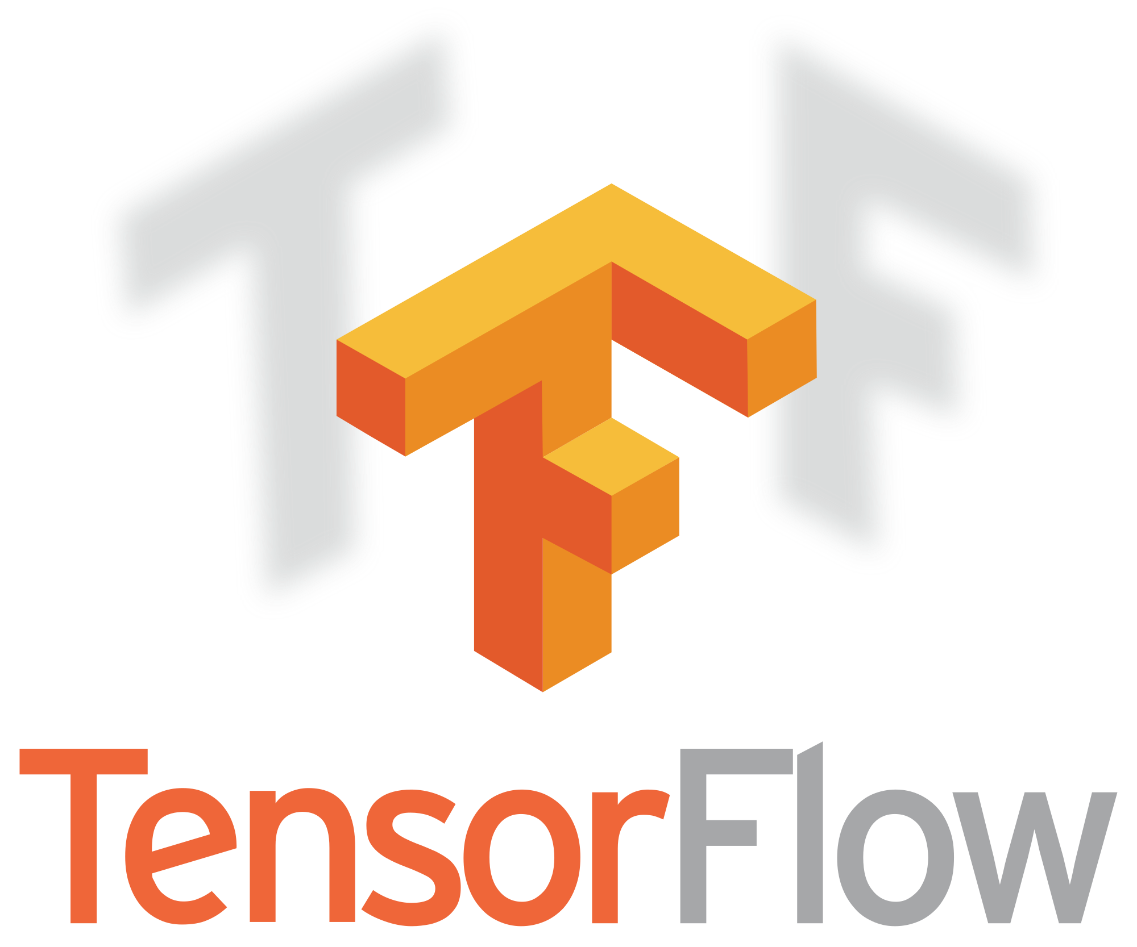
Introduction to
Tensorflow 2.0
Code

Slide 2


What is Keras
A High-Level API for building and training deep learning models
User Friendly
Modular and composable
Easy to Extend
Compatible with:
Tensorflow
CNTK
Theano
Notes:
Keras is a high-level API to build and train deep learning models. It's used for fast prototyping, advanced research, and production, with three key advantages
User friendly: Code is easy to understand
Modular and composable: Built on a modular design.
Easy to extend: Easy to take these modular parts and configure them in new ways to expand your research.
It was developed with a focus on enabling fast experimentation. Being able to go from idea to result with the least possible delay is key to doing good research.

Slide 3
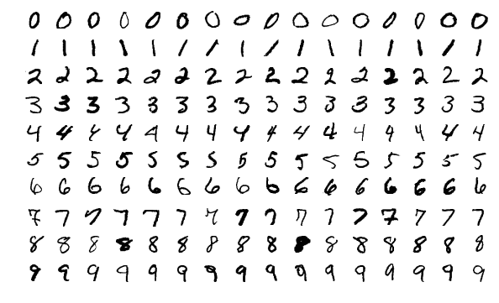
Our First Code Along!
Notes:
This will be an introductory code tutorial.
Here we are going to get used to Tensorflow 2.0, Keras, and Google Colab.
But first, information about our dataset

Slide 4
MNIST Dataset
60,000 images of hand written Digits
0-9
Introductory dataset for Machine Learning
We’ll be able to pass our model a hand written digit and it tell us what number it is.

Slide 5

Google Colab
Notes:
Notes for the Code:
-

